Slide 1
Parallel and Distributed GBT

Slide 2
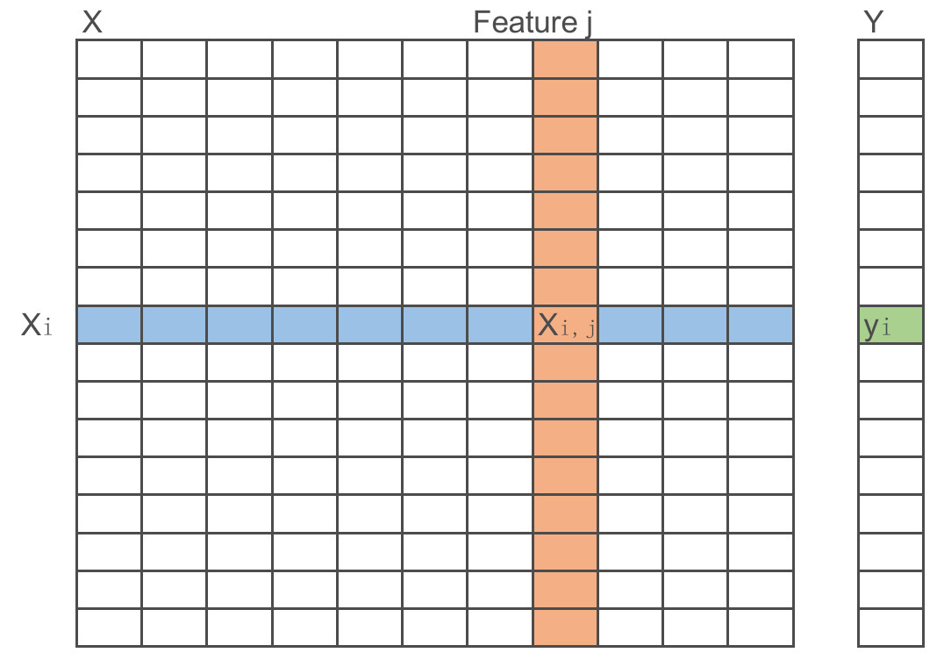
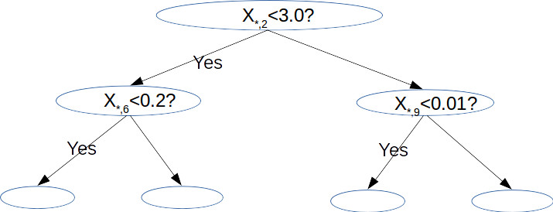
Data Partition
Single pass on train data for each level. (half when reuse GHSum_{_parent})
Keep GHSum of the same level in memory

Slide 3
dd

